Slide 1
Cloud Pipeline implementation with OpenShift Pipeline
OpenShift 4 : technical preview
Oren Oichman
Senior Cloud Consultant
Twitter : @ooichman
Medium : @ooichman
IRC: two_oes/ooichman

Slide 2

Cloud native CI/CD:

Slide 3
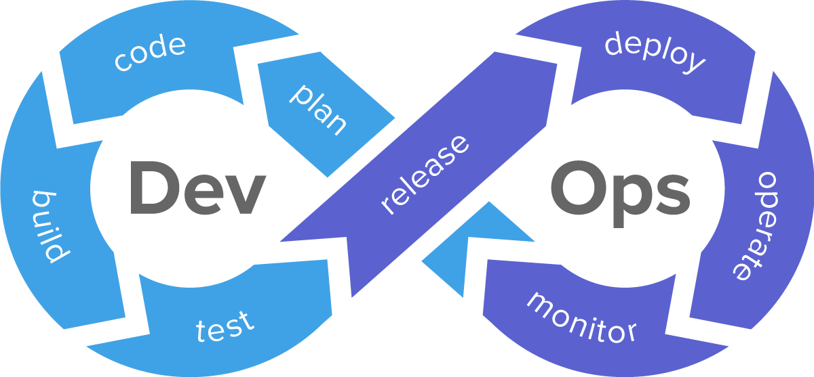
Why do we do CI/CD?

Slide 4
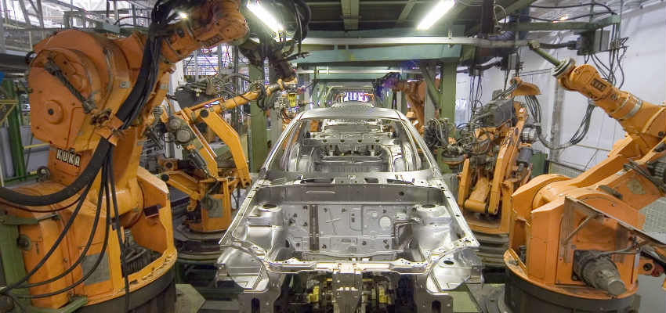
Quick continuous
feedback loop

Slide 5

Lots of changes in the last years...
Why do we do CI/CD?
Why do we do CI/CD?

Slide 6




Slide 7

Big paradigm shift
Why do we do CI/CD?
Why do we do CI/CD?

Slide 8

Is influencing the design of CI/CD tools make a difference ?
Notes:
This paradigm shift had also a huge impact on the design of CI/CD tools, which are embracing the power of container orchestrators as well.

Slide 9

Give the Power to the end user
Notes:
This paradigm shift had also a huge impact on the design of CI/CD tools, which are embracing the power of container orchestrators as well.

Slide 10



Not designed for the cloud

Slide 11
High Compute consumption
Bad scaling
Knowledge bottleneck

Slide 12


Slide 13
First k8s native pipeline execution engine

Slide 14
Defines five
Custom Resource Definitions

Slide 15
Pipeline Resource

Slide 16
inputs (e.g. git repository) and outputs (e.g. image registry) to and out of a pipeline or task

Slide 17
Task

Slide 18
a reusable, loosely coupled number of steps that perform a specific task (e.g. building a container image)

Slide 19
TaskRun

Slide 20
the execution and result of running an instance of task

Slide 21
Pipeline

Slide 22
the definition of the pipeline and the Tasks that it should perform

Slide 23
PipelineRun

Slide 24
the execution and result of running an instance of pipeline, which includes a number of TaskRuns

Slide 25
Trigger

Slide 26
A Trigger captures an external event, such as a Git pull request and processes the event payload to extract key pieces of information

Slide 27
Condition

Slide 28
A Condition refers to a validation or check, which is executed before a Task is run in your Pipeline

Slide 29
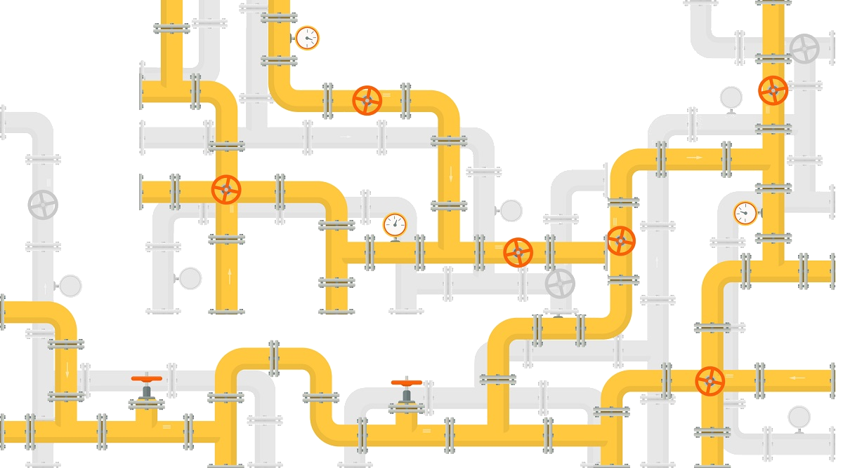
Tekton Pipelines are:
Cloud Native
Decoupled

Slide 30


Slide 31
THANK YOU
plus.google.com/+RedHat
facebook.com/redhatinc
linkedin.com/company/red-hat
twitter.com/RedHatNews
youtube.com/user/RedHatVideos

